Slide 1

High Power Efficiency Design Approach of a LLC Resonant Converter for UPS Battery Charger Application and Battery Charge-Discharge Regression Model
Graduatıon project
Turhan Can KArgın

Slide 2


High Power Efficiency Design Approach of a LLC Resonant Converter for UPS Battery Charger Application and Battery Charge-Discharge Regression Model
SUPERVISOR: Assoc. Prof. Savaş ŞAHİN
CO-SUPERVISOR: Fırat DEVECİ – TESCOM Elektronik A.Ş.
This work is supported by the Scientific and Technical Research Council of Turkey (TUBITAK) under 2209B-Bachelor Final Thesis Focused on Industry Program with Project number 1139B411900874.
This work is presented in 2nd International Conference of Applied Sciences, Engineering and Mathematics (ICASEM 2020).

Slide 3
Introduction
This presentation present the analysis and design considerations for a half-bridge LLC resonant DC-DC converter. Using the fundamental approximation, the voltage and current waveforms are analyzed and the gain equations are obtained. Half-bridge LLC resonant converter has 400V input and 48V/3.1A output.The circuit is simulated using PSIM software. In addition, it is presented as secondary output to find the charge-discharge models under varying conditions by deriving the regression models with machine learning algorithms where the battery electricity energy consumption, battery status and temperature data can be analyzed.

Slide 4
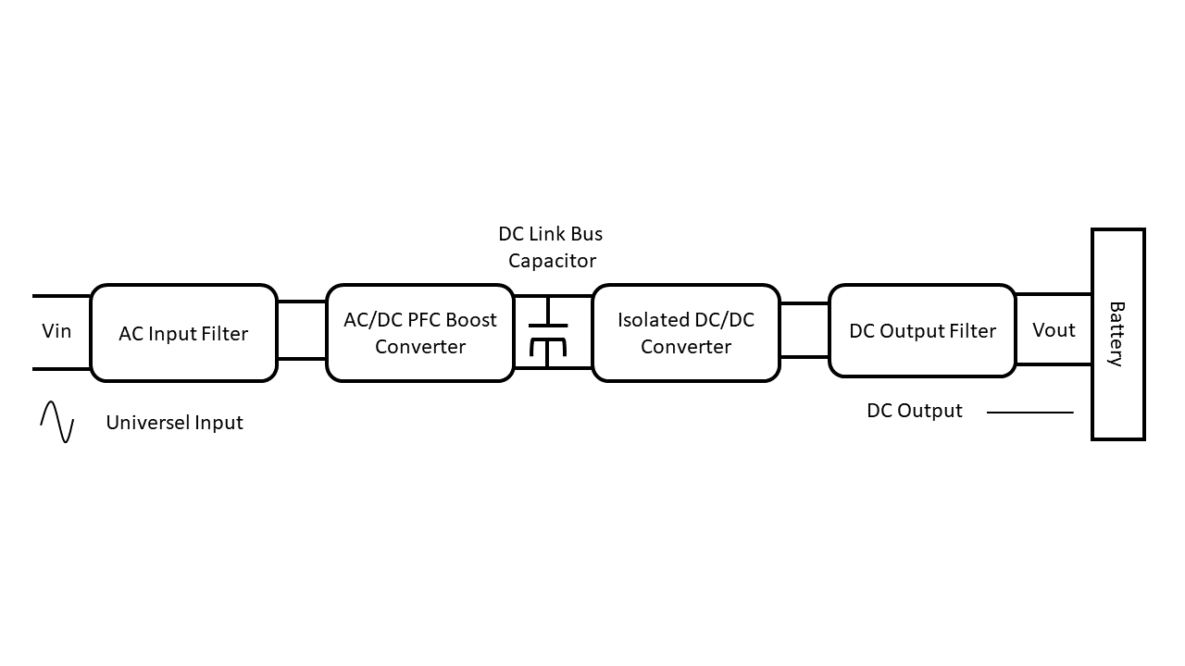
LLC Rezonant Converter
1. The advantages of LLC Rezonant Converter
2. Why to use as UPS Battery Charger
Block diagram of a universal battery charger

Slide 5
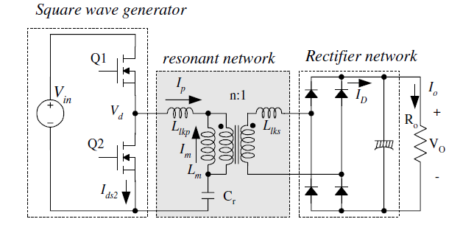

Circuit Design
Define the system specifications and determine the maximum and minimum voltage gains of the resonant network
$P_{in}=\frac{P_{out}}{E_{ff}}$
$V_{in}^{max}=V_{o.PFC}$
$V_{in}^{max}=\sqrt{V_{O.PFC}^{2}−\frac{2P_{in}T_{HU}}{C_{DL}}}$
$M^{min}=\sqrt{\frac{m}{m−1}}$
$M^{max}= \frac{V_{in}^{max}}{V_{in}^{min}}M^{min}$
A schematic of half-bridge LLC resonant converter

Slide 6
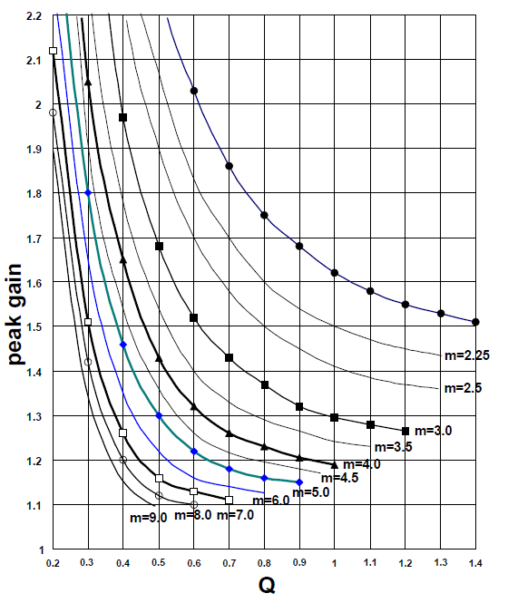

Circuit Design
Calculate the Equivalent Load Resistance and Design the resonant network
$R_{ac}= \frac{8n^{2}}{π^{2}}\frac{V_{0}^{2}}{P_{0}}$
$C_{r}=\frac{1}{2πQ.f_{o}.R_{ac}}$
$L_{r}=\frac{1}{4π^{2}f_{o}^{2}C_{r}}$
$L_{p}=m.L_{r}$
With m value chosen in previous slide, read proper Q value from the peak gain curves in Figure that allows enough peak gain. Considering the load transient and stable zero-voltages-witching (ZVS) operation, 10~20% margin should be introduced on the maximum gain when determining the peak gain.
Peak Gain (Attainable Maximum Gain) vs. Q for Different m Values

Slide 7
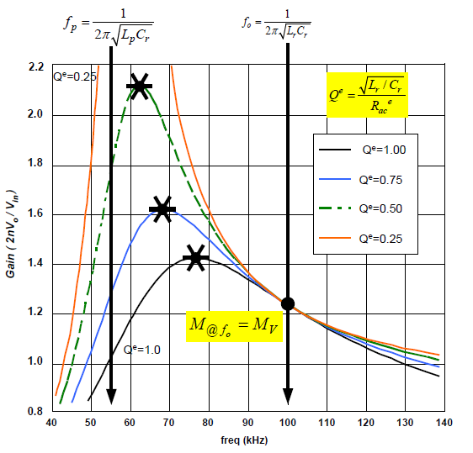

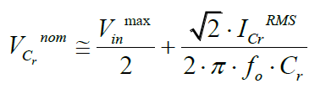


Circuit Design
Design the transformer and select the resonant capacitor
$$N_{p}^{ min}=\frac{n(V_{o}+V_{F})}{2f_{s}^{min}∆B.1,12.A_{e}}$$
From the gain curve of Figure, the minimum switching frequency will be obtained
Typical Gain Curves of LLC Resonant Converter

Slide 8
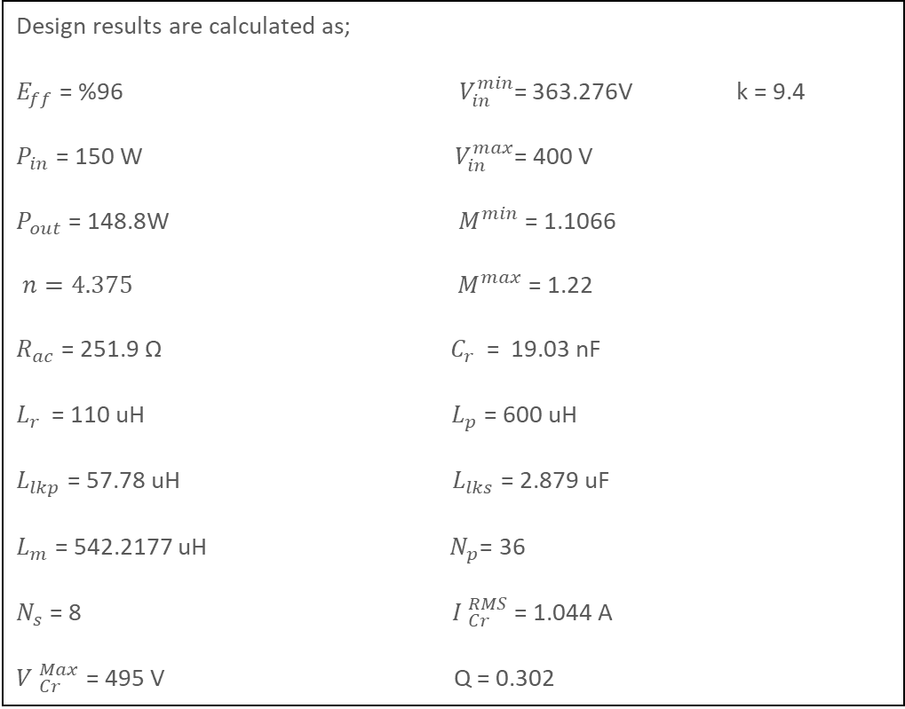
Design Specification
Design results are calculated as;
$E_{ff}$ = %96$V_{in}^{min}$= 363.276V k = 9.4
$P_{in}$ = 150 W ${ V}_{in}^{max}$= 400 V
$P_{out}$ = 148.8W${ M}^{min}$ = 1.1066
$n=4.375 { M}^{max}$ = 1.22
$R_{ac}$ = 251.9 Ω ${ C}_{r }$ = 19.03 nF
$L_{r }$ = 110 uH${ L}_{p}$ = 600 uH
$L_{lkp}$ = 57.78 uH${ L}_{lks}$ = 2.879 uF
$L_{m}$ = 542.2177 uH${ N}_{p}$= 36
$N_{s}$ = 8${ I }_{Cr}^{RMS}$ = 1.044 A
${V }_{Cr}^{Max}$ = 495 V Q = 0.302
Define Ratio ‘n’
Define Value of Mmax-Mmin
Select Value of k and Q
Check M, k and Q Graph
Are the values of M, k and Q is in the Limit.(ZVS)
NO
YES
Calculate ‘Rac’
Therotical calculation results
Calculate ‘Cr’
Circuit design results

Slide 9
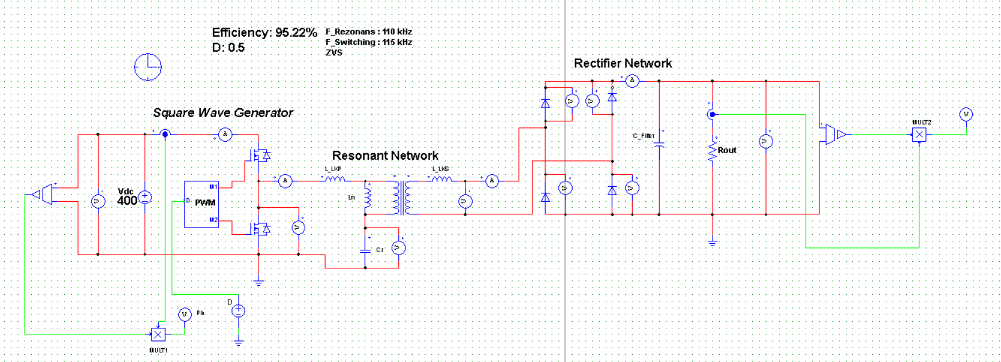
Simulation Results

Slide 10
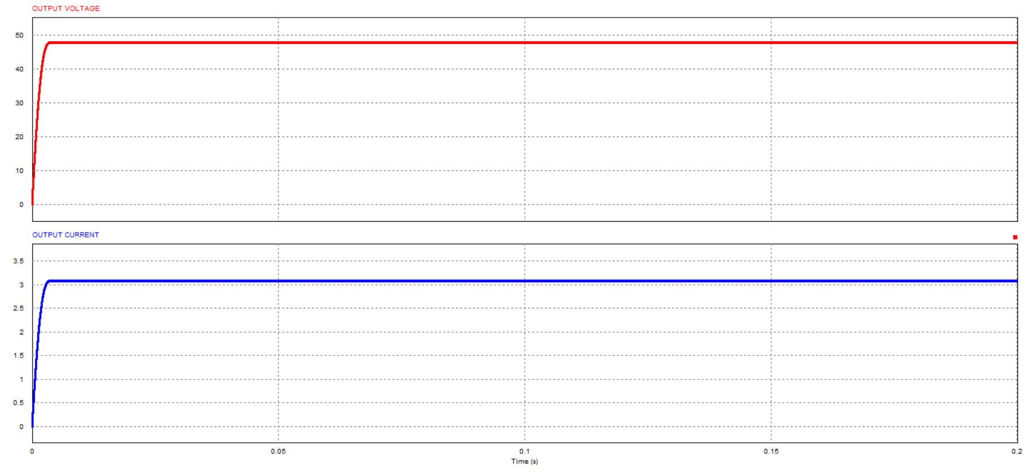
Simulation Results
Output Voltage (V) and output current (A) of the LLC Resonant Converter

Slide 11
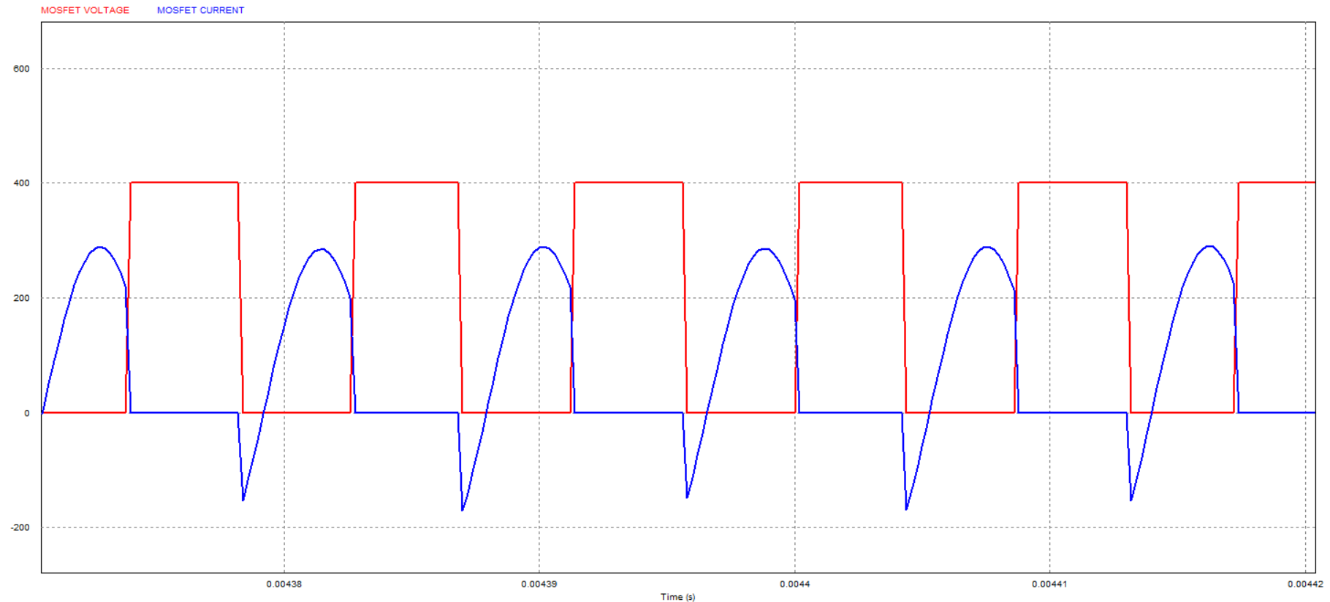

$E_{ff}$ = %9$5.22$
MOSFET voltage (V) and current (A) achieving soft switching

Slide 12
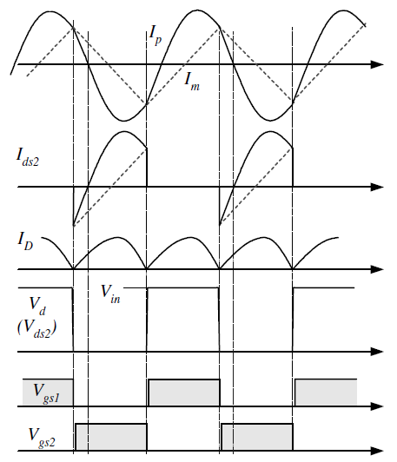
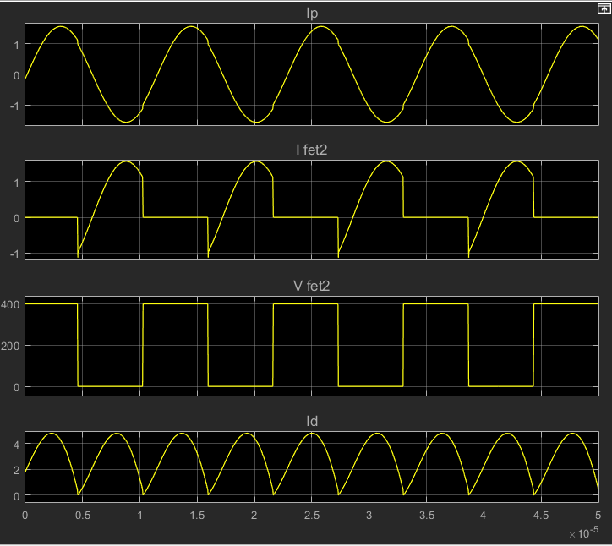
Typical Voltage (V) and current (A) waveforms of half-bridge LLC resonant converter
Simulation Voltage (V) and current (A) waveforms of resonant converter

Slide 13
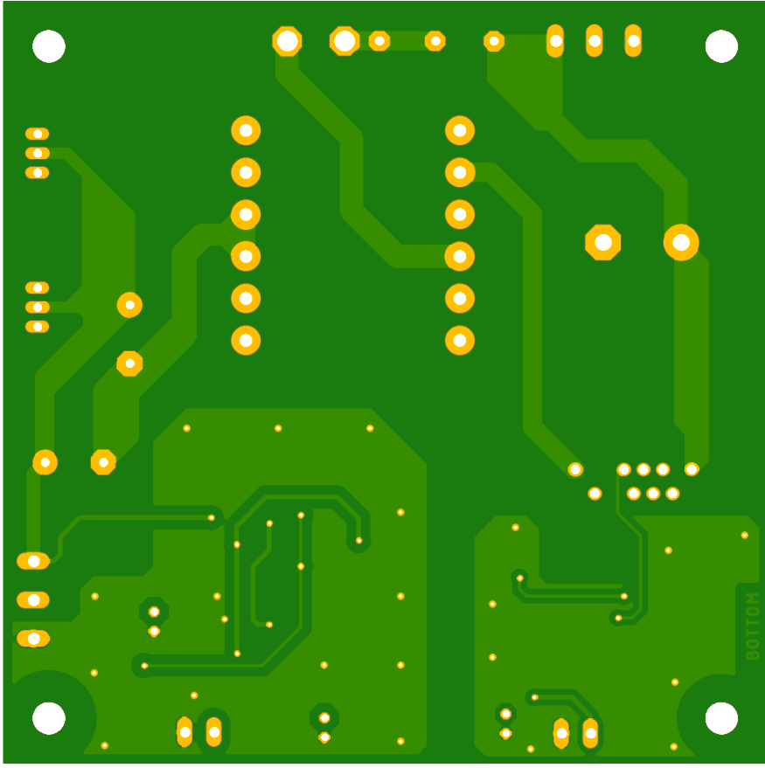
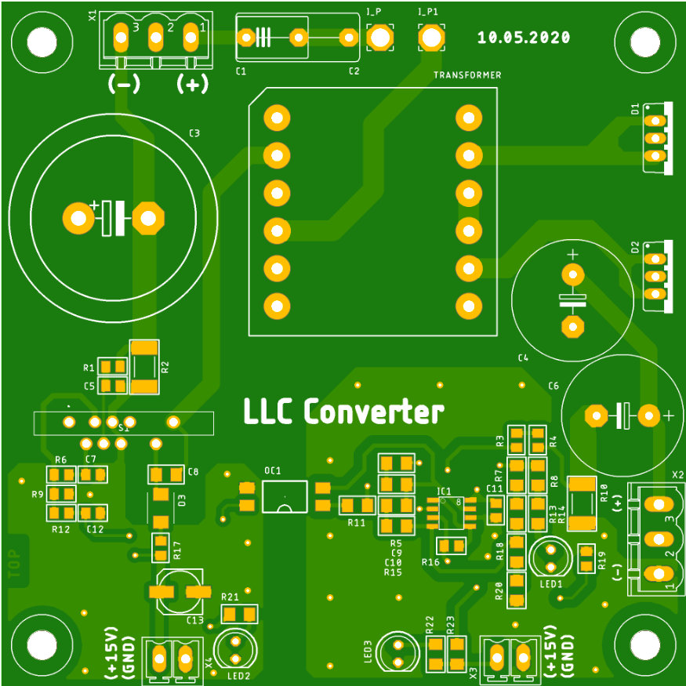
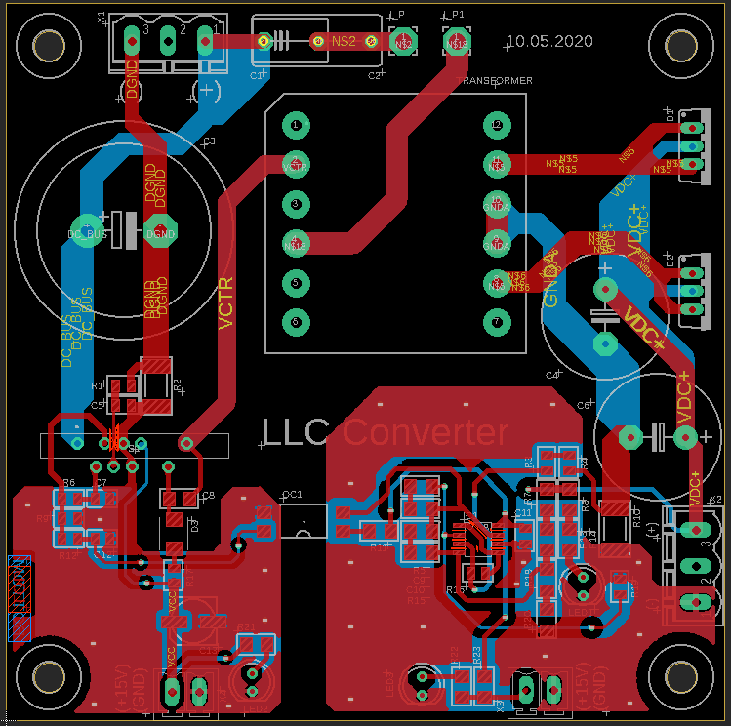
PCB Design

Slide 14
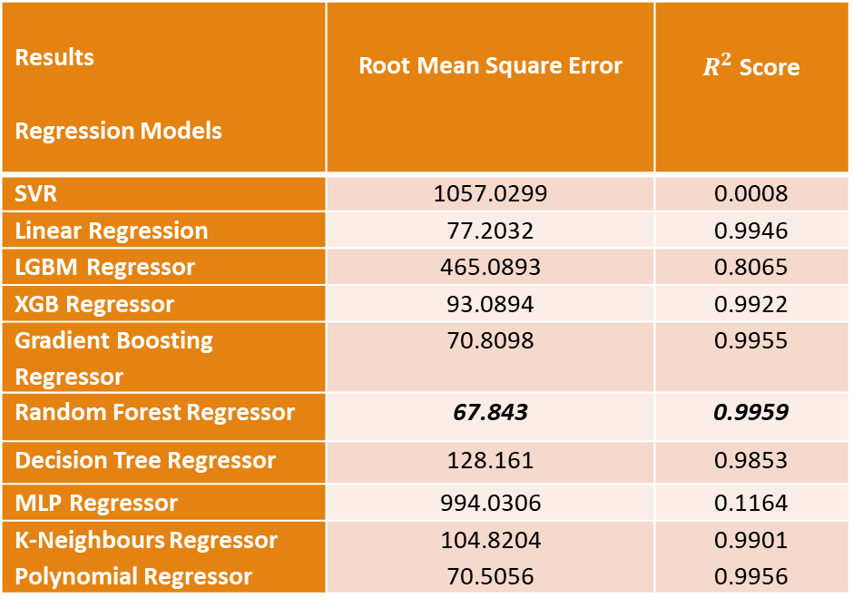
Regression Models with Machine Learning
Results Regression Models | Root Mean Square Error | $R^{2}$ Score
SVR | 1057.0299 | 0.0008
Linear Regression | 77.2032 | 0.9946
LGBM Regressor | 465.0893 | 0.8065
XGB Regressor | 93.0894 | 0.9922
Gradient Boosting Regressor | 70.8098 | 0.9955
Random Forest Regressor | 67.843 | 0.9959
Decision Tree Regressor | 128.161 | 0.9853
MLP Regressor | 994.0306 | 0.1164
K-Neighbours Regressor Polynomial Regressor | 104.8204 70.5056 | 0.9901 0.9956
Regression model comparison using Python

Slide 15
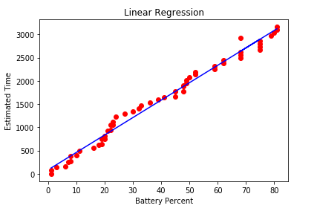
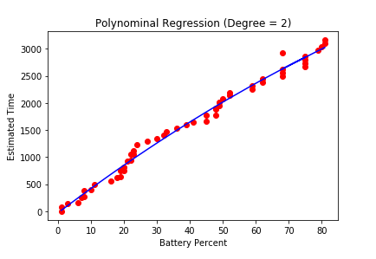
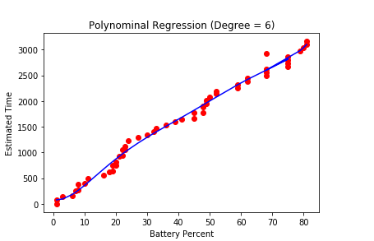
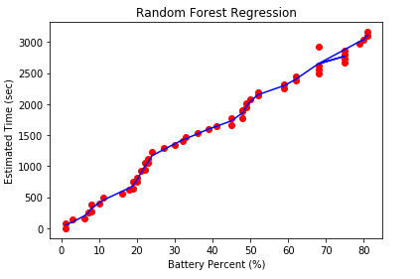
Regression Models with Machine Learning
Visualization of battery discharge regression models

Slide 16

Thank You

